Slide 1
Covid-19 Analysis Presentation.
By Tochukwu Emmanuel.

Slide 2
Source of data: https://github.com/no37no37/covid19_micro_analysis/blob/main/covid_19_data.csv
Introduction:
The dataset contains detailed updates on the covid-19 pandemic status of several countries (Region) in the world on April 29, 2020.
Notes:
These details includes numbers of recovered, deaths and confirmed cases in those countries.

Slide 3
Tools used:
Power query ( for data cleaning/ preparation)
Power BI

Slide 4
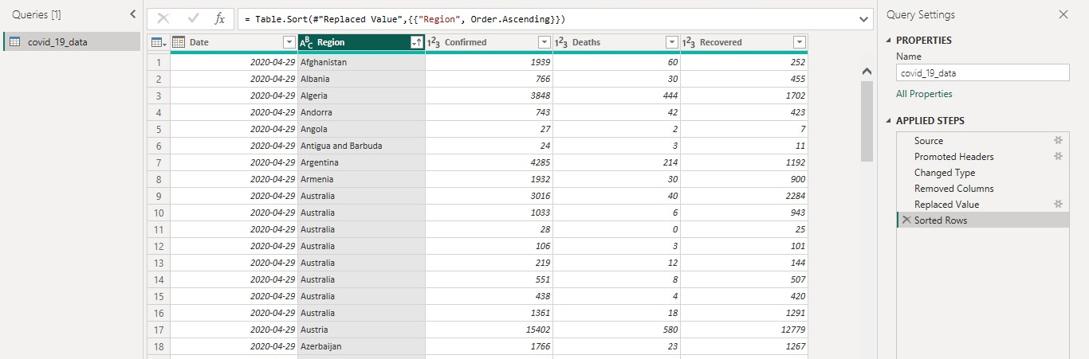
Data cleaning processes.

Slide 5
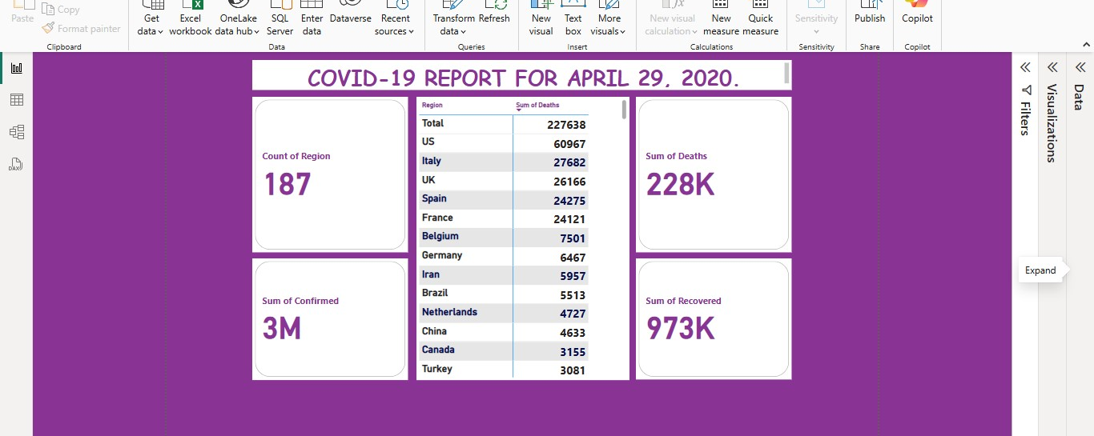
Power BI Dash board.

Slide 6
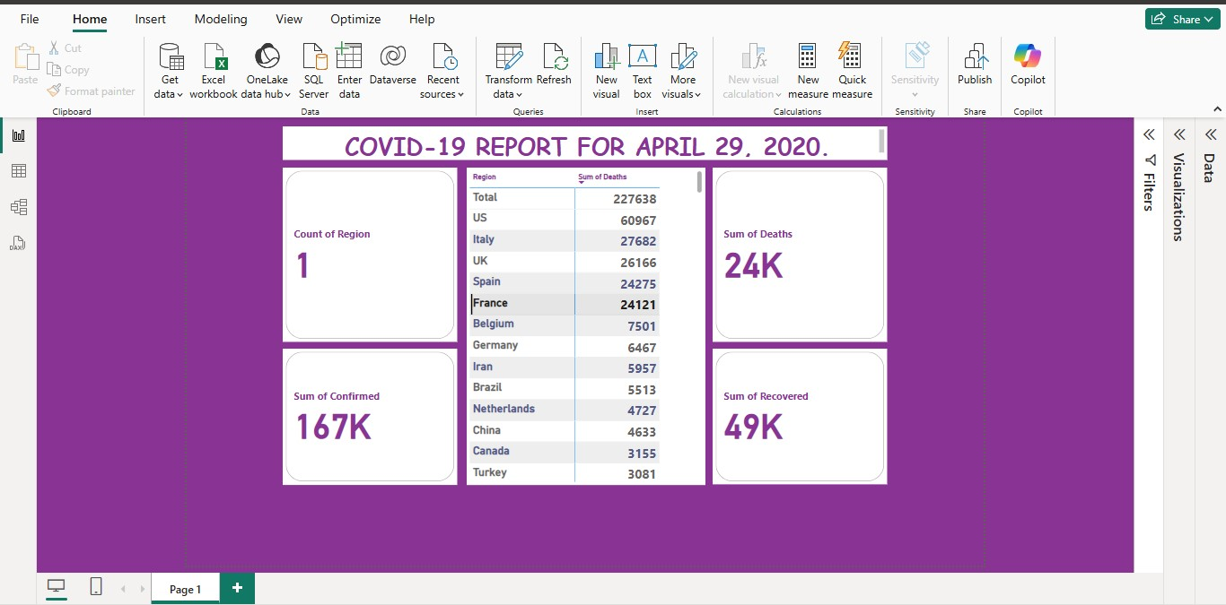
Notes:
We can now see that the dashboard is highly interactive

Slide 7
Recommendations:
Every country should carry out a public health education on the pandemic subject.
Empower biomedical engineers to produce ‘point of care testing’ materials for self diagnosis and such materials should be distributed to every household in the country.
Encourage the intake of hot fluids to the citizens.
Vaccination should be encouraged if any have been produced.
Targeted delivery buccal, sublingual or throat absorbed choices of medications should be used often for other treatments during this pandemic.
Quarantine, social distancing and masking should also be encouraged.

Slide 8
THANK YOU!

